Slide 1

INFRAMIND 2019
_ATOM_
from Bannari Amman Institute of Technology

Slide 2
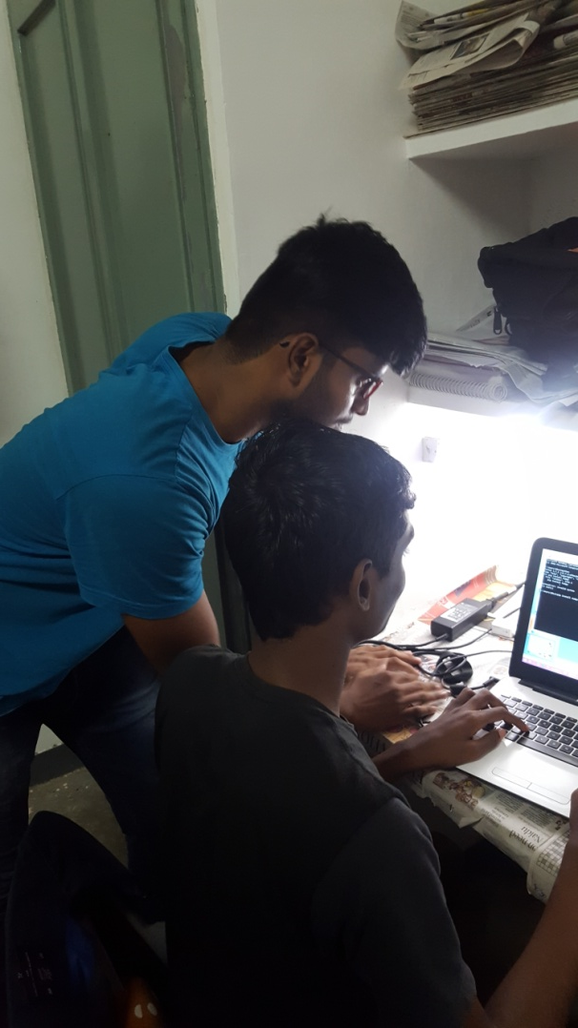
Team Members
Balamurugan T 161ME117
Department of Mechanical | Final Year | 9488641192 | tbala2805@gmail.com
Praveen V 161MC167
Department of Mechatronics | Final Year |8883168568 | praveen241298@gmail.com

Slide 3
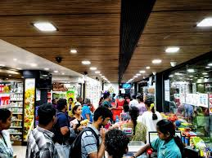
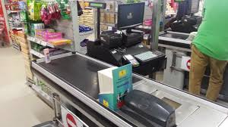
Problem Statement
In Retail Store,Customers–Spend more time in Billing counters
Delayed check out systems
Affect the sales

Slide 4
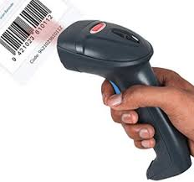
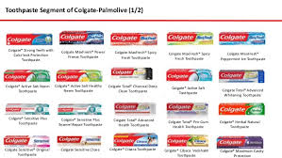
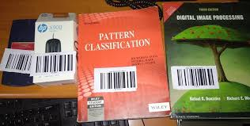
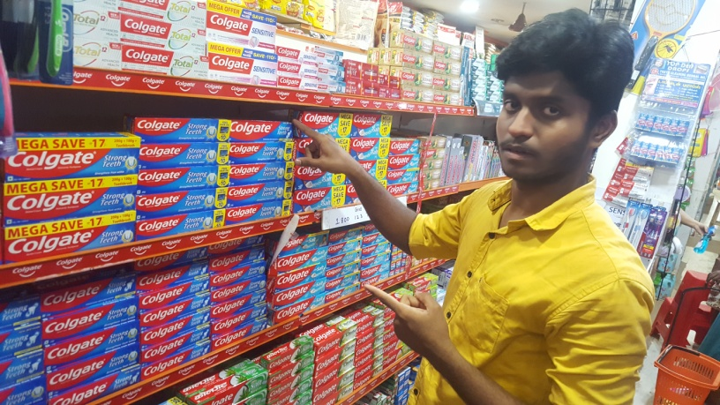
Limitations of Existing method
Damaged labels hard to scan
Searching of barcode-Very difficult
Multiple products are tedious

Slide 5
Proposed solution
ML
Edge
computing
Automate
Checkout
Capture
Neural networks
w.r.t brand & size
Identify products
Process the image
Our model detect the product

Slide 6


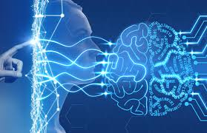

Industry 4.o

Slide 7

Tools
Web camera
Xampp
Darkflow
Python 3.7
Laptop

Slide 8
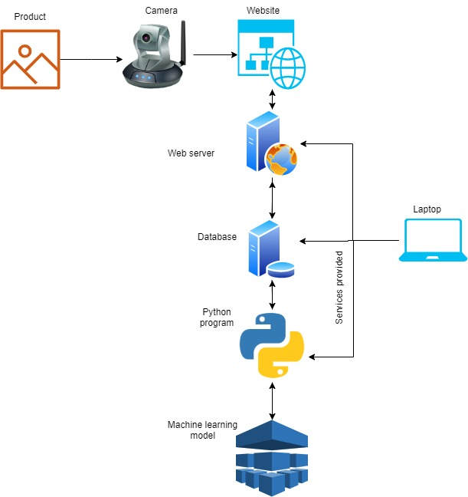
Architecture

Slide 9
Working-Client side
Open web application-Shows the live video feed from camera
Taking the snapshot of the product and add to cart finally submit those.
The images are submitted in base64 string format.
The detection process are redirected to the billing process

Slide 10
Server Side:
After submitting-Pressed php script receives the image in base64 string format and then image is decoded and stored in local storage
Python script get the image details from the database and run the neural network to detect the product. After detection, the label and size of the product is updated to the database.

Slide 11
Php script get the label detail from the database and compared with the available products and shows the bill to the user.
Size of the object is compared with reference
These two must be in same plane for better to find the exact size

Slide 12
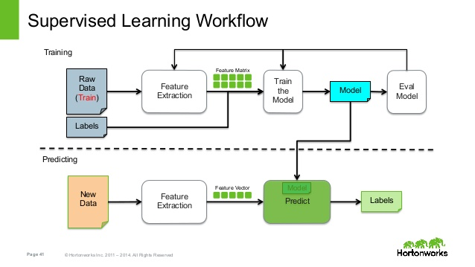
_Atom_

Slide 13
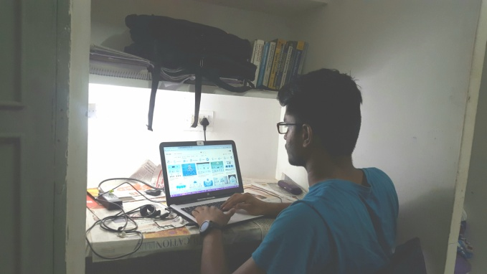

Scope of Automation
Future scope ->
Human taking Images will avoided
Improved ML
Facility to detect
Multiple products
from single image

Slide 14
Move Further!....

